Slide 1

GROUP CHROMOSOMES
A PRESENTATION ON THE FASTA ALGORITHM

Slide 2

FASTA
FASTA, pronounced fast A (“FASTA”) stands for FAST-ALL for its ability to work with all the alphabets of the English language in searching. It is the extended version of the previous FAST-P and FAST-N alignment tools for searching protein and nucleotide sequences. As an alignment tool, it uses heuristics in its pairwise alignment to find similarity or homologous sequences of residues, i.e., nucleotides and amino acids in a database. It was created in 1985 by David J. Lipman and William R. Pearson. Even though it does not give an optimal result in terms of selectivity and sensitivity just as BLAST, it has increased the speed of searching significantly as compared to the old exhaustive method that uses dynamic programming by 50-100%. The exhaustive method, though accurate, is very slow and expensive computationally

Slide 3
VARIANTS OF FASTA
There are several variations of FASTA:
FASTX translates DNA sequences and aligns them to protein sequences, allowing gaps and frameshifts between codons, but not substitutions or frameshifts within a codon.
FASTY allows substitutions or frameshifts within a codon, which can detect more distantly related proteins but may result in more false positive matches.

Slide 4
VARIANTS OF FASTA
TFASTX translates DNA sequences in all six frames, only allowing gaps between codons to identify protein-coding regions.
TFASTY allows gaps within codons, potentially leading to different amino acids being encoded, but also increasing false positive
matches.
TFASTA can identify genes and their functions in DNA sequences, and search for sequence similarities between proteins and DNA
sequences to provide insights into evolutionary relationships and functional conservation.

Slide 5
FASTA: A LOCAL OR GLOBAL SEQUENCE ALIGNMENT TOOL?
The FASTA algorithm is primarily designed for local sequence alignment but can also be used for global alignment. It was developed in the early 1980s by William Pearson as a heuristic approach to search for regions of similarity between the query sequence and a database of sequences. The algorithm is particularly useful for identifying conserved regions within proteins or nucleic acids, where there may be non-conserved regions or regions with low sequence similarity. Modifications to the scoring matrix and gap penalties can enable the algorithm to be used for global sequence alignment, and newer versions of the program allow for both local and global alignment.

Slide 6
KEY PROPERTIES OF FASTA ALGORITHM
Speed: The FASTA algorithm is designed to quickly search databases of sequences and identify those with significant similarity to a query sequence. This makes it particularly useful for analyzing large datasets.
Sensitivity: The FASTA algorithm is highly sensitive and can detect remote homologues that may not be detected by other alignment methods. This makes it particularly useful for identifying evolutionary relationships between sequences. It is thought to be more sensitive than BLAST.
Flexibility: The FASTA algorithm can be used to search both nucleotide and protein databases and can be applied to a wide range of sequence analysis problems, such as gene prediction, protein classification, and phylogenetic analysis.

Slide 7
APPLICATIONS OF FASTA
FASTA is a widely used tool in bioinformatics for a variety of applications, including:
Sequence alignment: FASTA is used to align protein or nucleotide sequences to identify homologous sequences that share structural or functional similarity.
Gene annotation: FASTA can be used to identify potential coding regions in genomic DNA sequences by comparing them to known protein sequences.
Phylogenetic analysis: FASTA can be used to compare sequences across different organisms, allowing for the construction of evolutionary trees and the identification of conserved regions.
Protein structure prediction: By identifying homologous sequences, FASTA can be used to predict the structure of proteins and their binding sites.

Slide 8
HOW FASTA COMPUTES THE FINAL ALIGNMENT SCORE
FASTA uses shorter forms of windows called ktuples in its searching, which make it more sensitive than BLAST. It uses two residues of proteins and six residues of nucleotides during the initial stage of alignment. The expectation value (E) distinguishes between evolutionary related or non-related sequences, and a lower E-value indicates a more accurate result. The bit score and z-score are also used for evaluation, with a z-score greater than 15 indicating a perfect match. To eliminate false positive similarities, Low Complexity Regions (LCRs) are filtered using masking. Using protein sequences as queries and rechecking alignments with independent programs can improve search results.

Slide 9
HOW THE FASTA ALGORITHM WORKS
The FASTA algorithm looks for matching substrings of length ktup in two strings, which are called hot spots. Consecutive hot spots are located along the dynamic programming matrix diagonals. A lookup table or a hash is used to efficiently search for these hot spots.
The algorithm looks for the 10 best diagonal runs of hot spots in the matrix. A diagonal run is a sequence of nearby hot spots on the same diagonal,and is evaluated using positive scores for hot spots and negative scores for spaces between consecutive hot spots. The 10 highest scoring diagonal runs are found.
A diagonal run is aligned using an amino acid or nucleotide substitution matrix, and the best subalignment found is called init1. Filtration is performed, and low-scoring diagonal runs are discarded.
Good diagonal runs from close diagonals are combined to achieve a subalignment with indels allowed. A directed weighted graph is constructed to represent the subalignments, and a maximum weight path is found to obtain the best alignment called initn.

Slide 10
HOW THE FASTA ALGORITHM WORKS
An alternative local alignment score, opt, is computed by assuming the best alignment path lies within a narrow diagonal band in the matrix centered along the init1 segment.
The database sequences are ranked according to initn or opt scores, and the full dynamic programming algorithm is used to align the query sequence against each of the highest-ranking result sequences. The resulting alignment scores are comparable to the optimal alignment, while the FASTA algorithm is faster.

Slide 11
KEY STEPS OF HASHING
1. Find ktups in both sequences using hashing
Match sequences in a lookup table in ascending order
Calculate the positional value of each ktuple
Calculate the difference between ktuples in both sequences as an offset value
Sequences with equal offset value show identity as diagonal lines in a substitution matrix
2. Narrow down regions of high similarity
Select top 10 regions with dense diagonals or equal offset values
For substitution matrix, score diagonals and join high-scoring segments together after gap penalties

Slide 12
KEY STEPS OF HASHING
3. Refine gap alignment with dynamic programming algorithm, Smith-
Waterman algorithm
4. Refine final alignment using statistical evaluation
5. Evaluate expectation value to distinguish actual evolutionary links from chance/randomness
Normalize sequence similarity with bit score independent of query and database size
Calculate Z-score to determine number of standard deviations from mean score for any database search done with FASTA.

Slide 13
DEMONSTRATING HOW FASTA DOES PAIRWISE ALIGNMENT TO FIND SIMILARITY USING HASHING METHOD.
Say we have a query sequence of a protein residue; that is querying a database.
Query sequence: W A T S O N C R I C K
Database Sequence: B A L L C R I C K E T
Identifying ktuples in both sequences
a. Assign positional values for query sequence.
b. Assign positional values for query sequence.

Slide 14
DEMONSTRATING HOW FASTA DOES PAIRWISE ALIGNMENT TO FIND SIMILARITY USING HASHING METHOD.
3. Construct a hashing table to find the offset between the 2 positional values.
4. Regions with equal values of offset show similarity
Hence a positive right shift of the database sequence yields.
W A T S O N C R I C K - -
| | | | |
- - B A L L C R I C K E T
Hence the CRICK shows regions of similarity.

Slide 15
FASTA CODE IMPLEMENTATION
Since FASTA is a database searching tool, we will require a database. Hence, we created a sqlite3 database to store our sequences, annotated or not, which a query will be used to find match. We tried to keep it as simple for demonstration purposes. We also kept the default parameters of
• match score = 1
• mismatch score = 0
• open gap score = 0
• extend gap score = 0

Slide 16
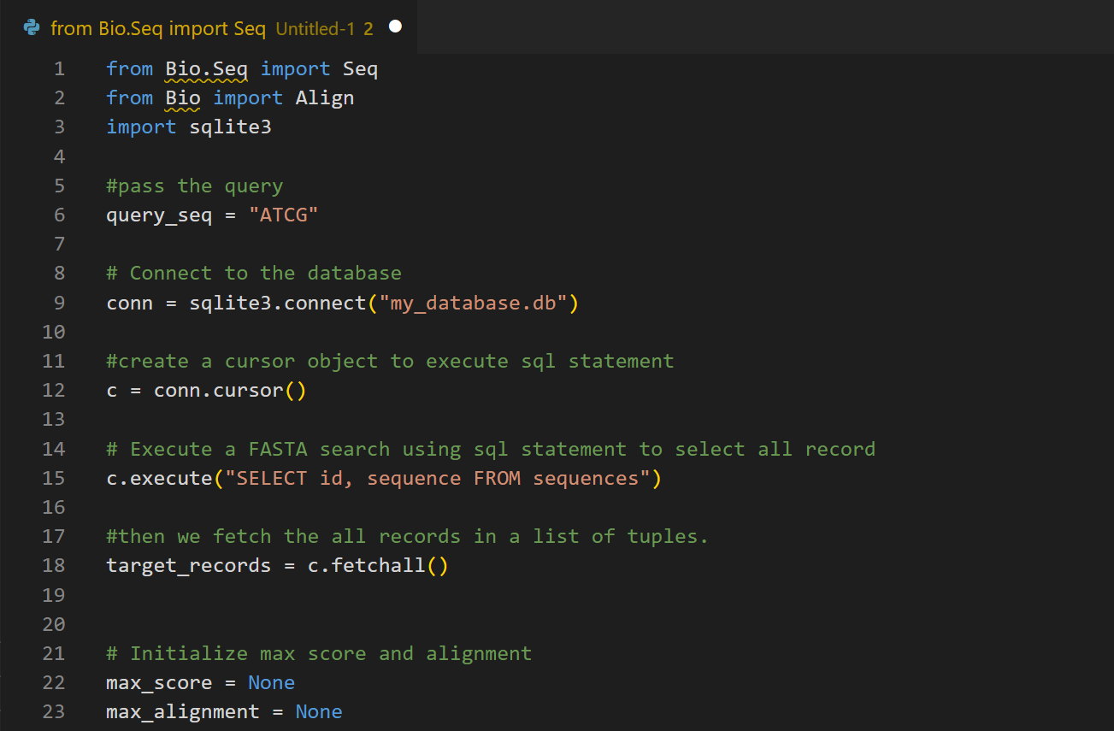
FASTA CODE IMPLEMENTATION

Slide 17
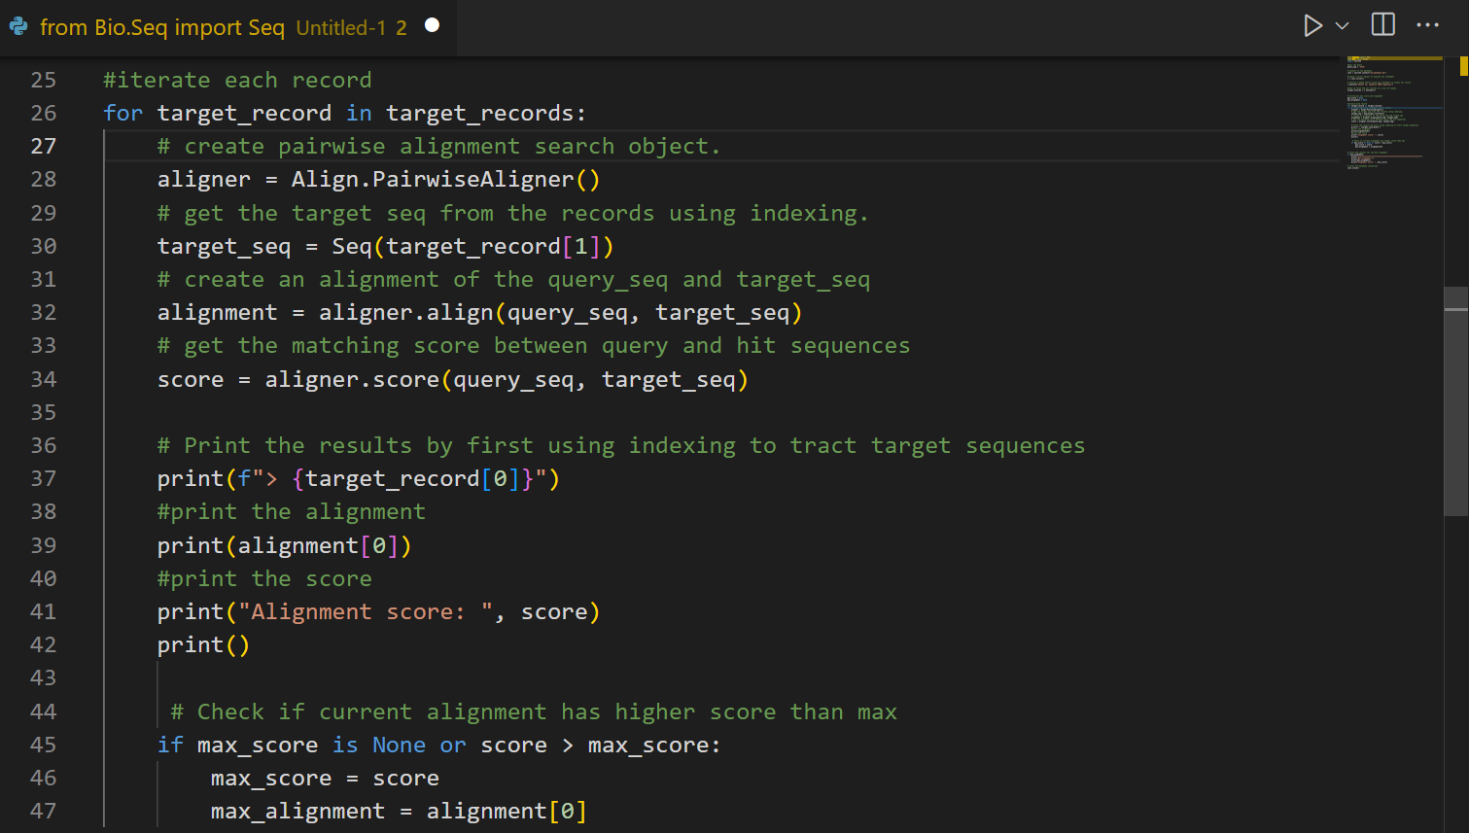
FASTA CODE IMPLEMENTATION

Slide 18
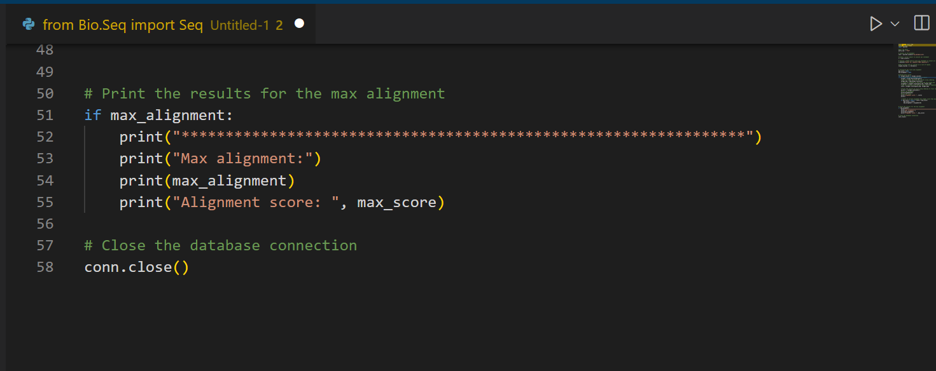
FASTA CODE IMPLEMENTATION

